Slide 1
Pragh:
Locality-preserving Graph Traversal
with Split Live Migration
speaker: Xiating Xie

Slide 2

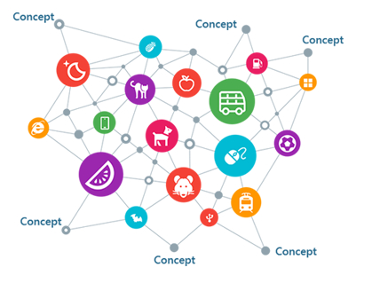
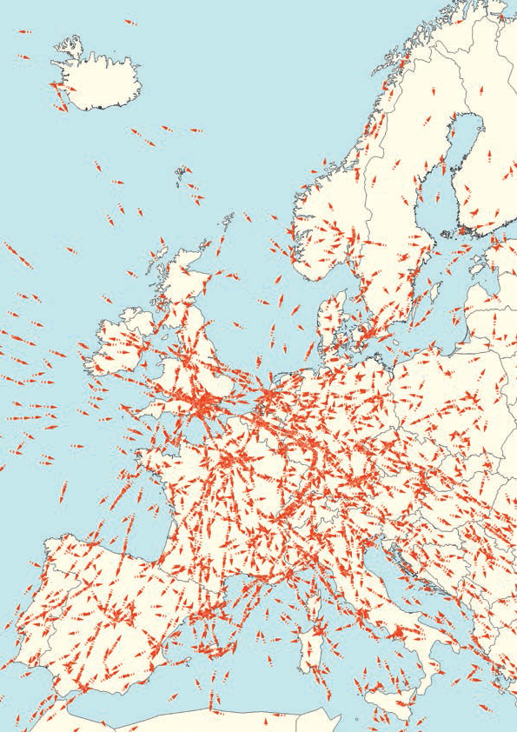

Graphs are Ubiquitous
Social networks
Knowledge database
Traffic networks

Slide 3

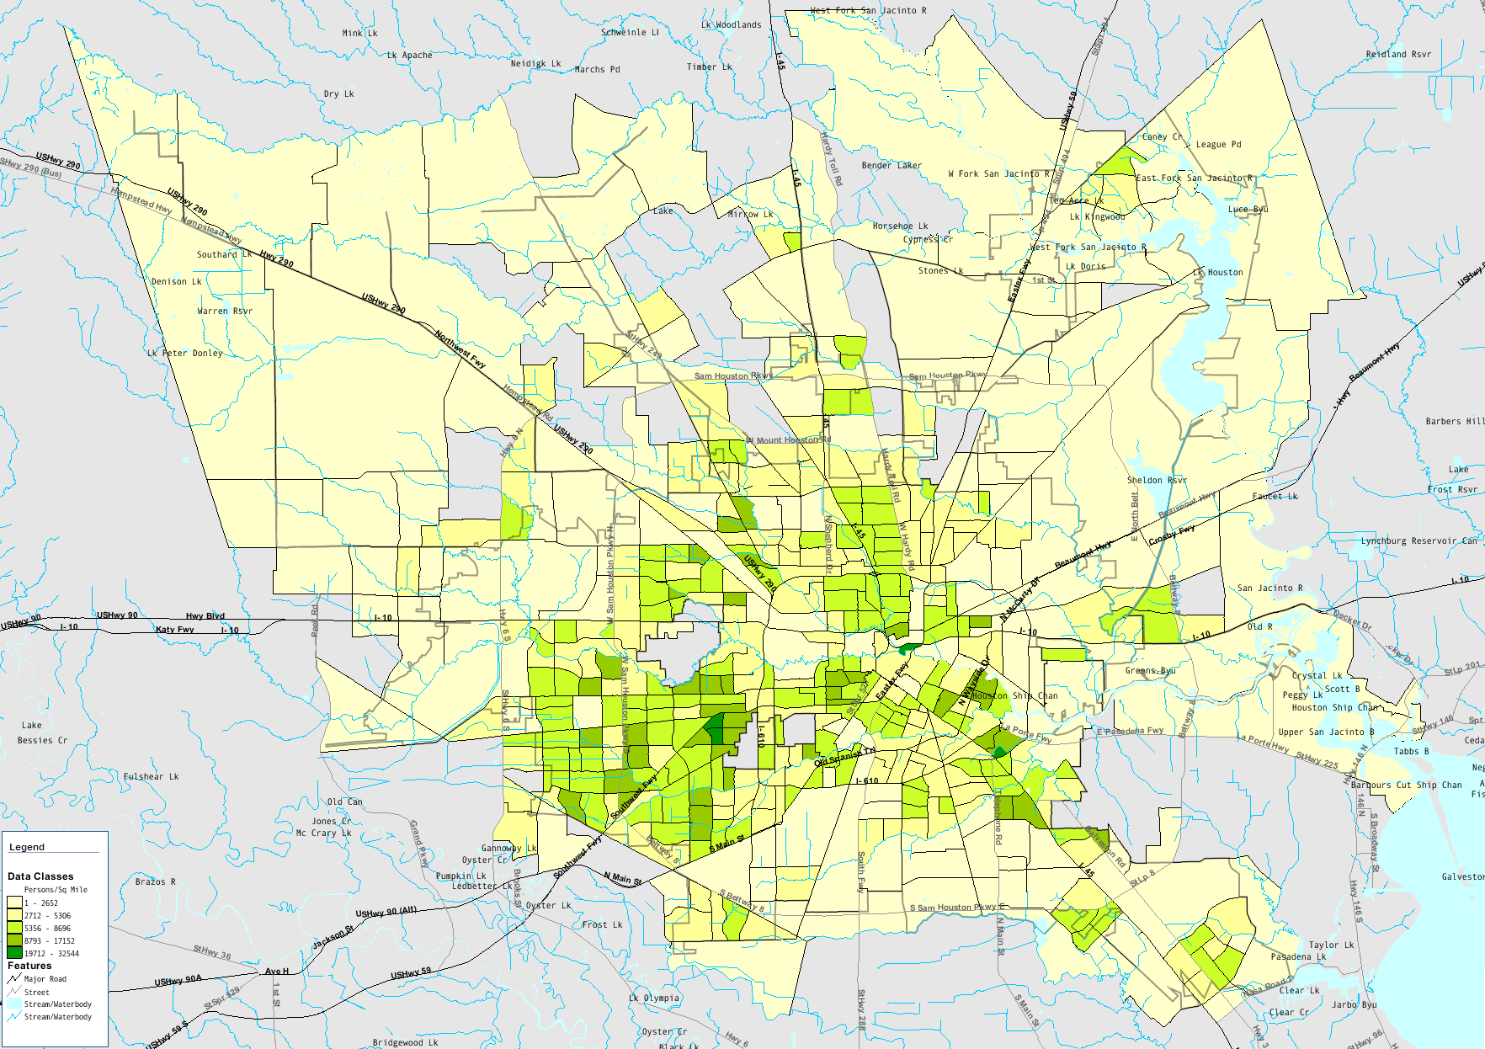
Graph Traversal Query
Important workload on graph store
5
5
7
7
3
2
1
2
1
6
query answering
4
8
8
2-hop query:
Q2(1)
8
2
user profiling
1
7
5
urban monitoring

Slide 4
Graph Store: Key-value Store
Graph
Key-value Store
M0
M1
5
7
5
7
key
value
key
value
3
3
. . . . .
8
. . . . .
2
1
2
1
6
6
1
7
8
2
1
4
4
.
4
8
3
5
4
5
2
8
8
7
1
2
.
4
. . . . .
. . . . .
6
3
. . .
8
2
5
Q2(1)
1
7
5

Slide 5
Locality: Important but Hard
Traversal: sensitive to locality
Distributed graph store: essential
Static partition-based approach
Dynamic workload, evolving graph
One partition schema cannot fit all !
Replication-based approach
Memory overhead
Sync cost (evolving graph)
25X
Median Latency(us)

Slide 6

Live Migration
Mechanism to preserve locality
Additional metadata to manage position
Before
After
M0
M1
M0
M1
P(key)
P(key)
POS
POS
H(key)
H(key)
KEY
KEY
addr
addr
Local Read
value
VAL
VAL
Send MSG

Slide 7
Live Migration
get(key)
P(key)
M0
M1
M0
M1
P(key)
P(key)
POS
POS
key
POS
H(key)
H(key)
H(key)
KEY
KEY
KEY
addr
addr
VAL
addr
value
VAL
VAL
Local Read
Send MSG

Slide 8
Shard-based Migration
One metadata for one shard
Irrelevant queries contend one shard
Graph
Metadata
shard | pos | vertices
1 | 1 | 1, 5
2 | 2 | 2, 6
3 | 1 | 3, 7
4 | 2 | 4, 8
8
2
5
7
Q2(1)
1
7
5
3
2
1
6
4
4
8
Q2(6)
6
3
5

Slide 9
Shard-based Migration
Increased performance in smaller shard
Good benefit: high memory overhead
NOT Scale !
64 kv/shard
log(#shard)

Slide 10
Shard-based Migration

Slide 11
Pragh: Split Live Migration
Opportunity: Remote Direct Memory Access(RDMA)
Migratory value and stationary key
Migrate in key-value pair with NO metadata
before
after
M0
M1
M0
M1
H(key)
H(key)
addr
KEY
addr
KEY
VAL
VAL
value

Slide 12
Migration
get(key)
M0
M1
M0
M1
H(key)
H(key)
H(key)
KEY
addr
KEY
addr
KEY
addr
VAL
VAL
VAL
value
Local Read
RDMA Read

Slide 13

Architecture
1
Task
Engine
3
1
. . .
worker
threads
Migration
Toolkit
Storage
Layer
migration
threads
2
key/value ops
RDMA NIC
get/put
3
Network
IB Switch
1
Task
Engine
3
plan
Migration
Toolkit
monitor
Storage
Layer
2
2
key-value
store
key-value
store
stat
. . .
RDMA NIC
. . .
coordinator

Slide 14
Challenges
How to migrate in key-value pair efficiently?
How to provide fully-localized access?
How to support evolving graph?
How to monitor in low overhead?

Slide 15
Challenges
How to migrate in key-value pair efficiently?
Unilateral migration protocol
How to provide fully-localized access?
Integrate with location cache
How to support evolving graph?
Check-and-forward mechanism
How to monitor in low overhead?
Reuse location cache

Slide 16
Address Layout
Support live migration concurrent with query
64-bit address: atomicity
key-value store
64
63
52
34
0
Value
Remote
Addr
1
ID
size
offset / 34
size/64
…
/7
/22
Local
Addr
0
size / 29
offset / 34
Key
ADDR

Slide 17
Unilateral Protocol
Migration done by only the target
M0
M1
M0
RDMA_CAS(a0, a1)
query
Key
ADDR
migration task
ADDR
RDMA_Write
a1 = Alloc(a0)
H(key)
Key
ADDR
ADDR
0
VAL
8
VAL
8
VAL
RDMA_Read
addr = a0
RDMA_Write(a0)
check validation
addr.size = val.size
0
VAL
8
VAL
Reclaim
Table
a0
Local
Addr
0
size / 29
offset / 34
background lease-based GC

Slide 18
Challenges
How to migrate in key-value pair efficiently?
Unilateral migration protocol
How to provide fully-localized access?
Integrate with location cache
How to support evolving graph?
Check-and-forward mechanism
How to monitor in low overhead?
Reuse location cache

Slide 19
Split Migration + Cache
Location cache: only cache address
A perfect counterpart to split migration
Eliminate another remote access
before
after
M0
M1
M0
M1
H(key)
H(key)
L$
KEY
L$
KEY
L$
Location Cache
addr
addr
VAL
VAL
Local Read
value
RDMA Read

Slide 20
Cache Coherency
M0
M1
query
H(key)
L$
Key
ADDR
addr
check
validation
8
VAL
value
Reclaim
Table
background lease-based GC

Slide 21
Cache Coherency
M0
M1
query
H(key)
expired?
L$
Key
ADDR
addr
check
validation
8
0
VAL
8
VAL
value
VAL
Reclaim
Table
background lease-based GC

Slide 22
Challenges
How to migrate in key-value pair efficiently?
Unilateral migration protocol
How to provide fully-localized access?
Integrate with location cache
How to support evolving graph?
Check-and-forward mechanism
How to monitor in low overhead?
Reuse location cache

Slide 23
Check-and-Forward Mechanism
Support evolving graph(PUT)
Conflicts: modification to address in key
Detected by RDMA_CAS
Forward PUT and retry migration
PUT
M0
M1
RDMA_CAS
RDMA_CAS
Key
ADDR
migration task
ADDR
copy_on_write
VAL
8
VAL
8
VAL

Slide 24
Split Migration + Cache
get(key)
M0
M1
M0
M1
H(key)
H(key)
H(key)
L$
KEY
L$
KEY
L$
KEY
addr
addr
addr
VAL
VAL
VAL
value
Local Read
RDMA Read
L$

Slide 25
Challenges
How to migrate in key-value pair efficiently?
Unilateral migration protocol
How to provide fully-localized access?
Integrate with location cache
How to support evolving graph?
Check-and-forward mechanism
How to monitor in low overhead?
Reuse location cache

Slide 26
Lightweight Monitor
Collect access statistics for migration plan
Track local and remote access separately
Local access:
Only a small fraction of data is migrated (0.2%)
Track on demand
Remote access:
Only care about key-value pairs accessed frequently
Reuse location cache (replacement policy)

Slide 27
Evaluation
Hardware configuration
Each node: 2 * 12-core Intel Xeon E5-2650 v4 processors, 128GB DRAM
Ideal: 1 * node
Distributed: 8 * node
Micro benchmark:
RMat-26 dataset, 2-hop query workload
Application benchmark:
Lubm-10240 dataset, mixed workload in Wukong

Slide 28
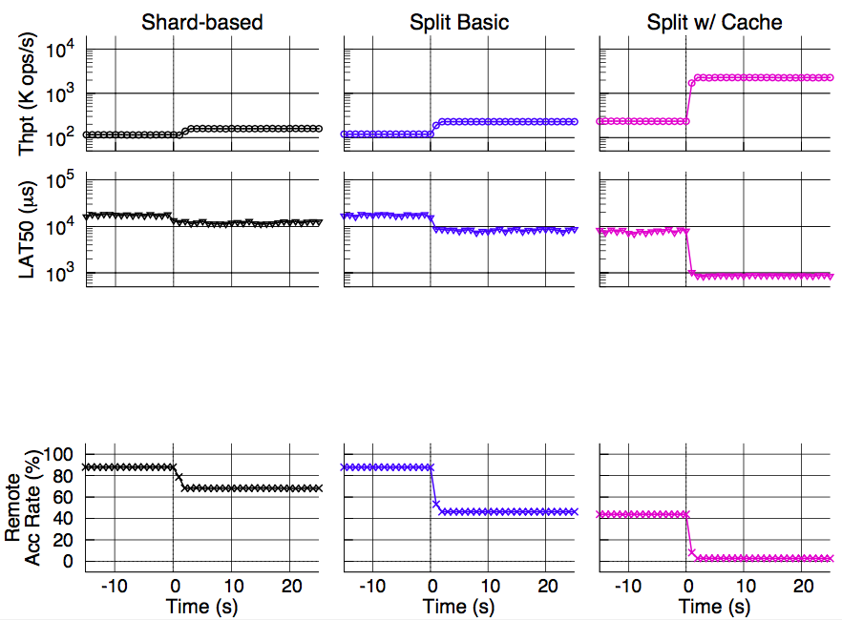
Migration Benefit
Micro benchmark: 2-hop query on RMat-26
+33%
+92%
+869%
-52%
migrate 84.5% data
migrate 0.13% data
-89%
-30%
-47%
-22%
-94%

Slide 29
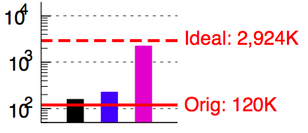
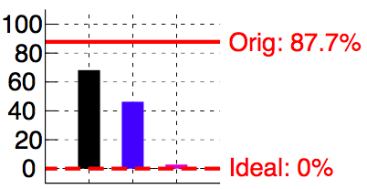
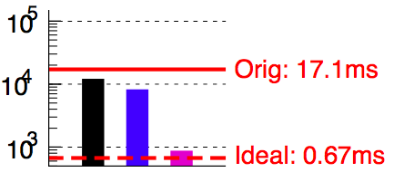
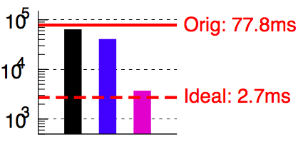
Migration Benefit
Micro benchmark: 2-hop query on RMat-26
Shard-based
Split Basic
Split w/ Cache
Throughput(K ops/s)
Remote rate(%)
Latency 50th%(us)
Latency 99th%(us)

Slide 30
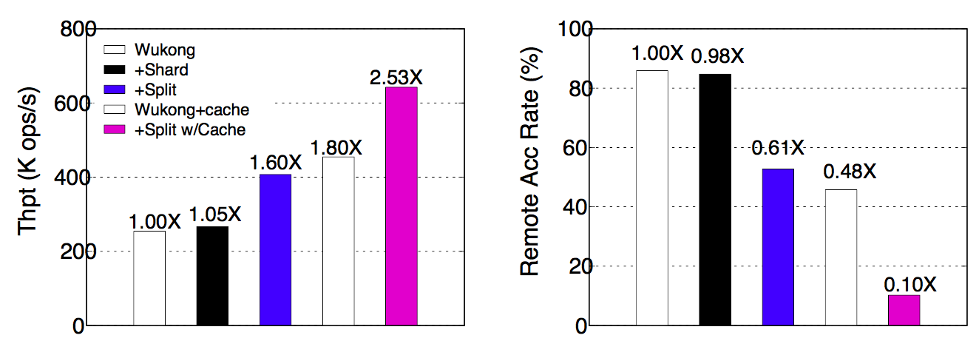
Application
Port split live migration to Wukong
2.53X throughput improvement

Slide 31
Summary
Questions & Thanks
Locality-preserving schema for graph traversal
Split Live migration
Migratory value and stationary key
Supporting techniques
Unilateral migration protocol, Reusing location cache, Check-and-forward mechanism
Significant performance benefit
Improve throughput 19X(micro), 2.53X(application)

Slide 32


